Slide 1

Nations’ Response to Covid-19:
A Critical Look
By Keshav Narasimhan
Upper St. Clair High School

Slide 2

Covid-19+Why I chose this Project

Slide 3
Problem and Hypotheses

Slide 4
Data Analyses Approach

Slide 5
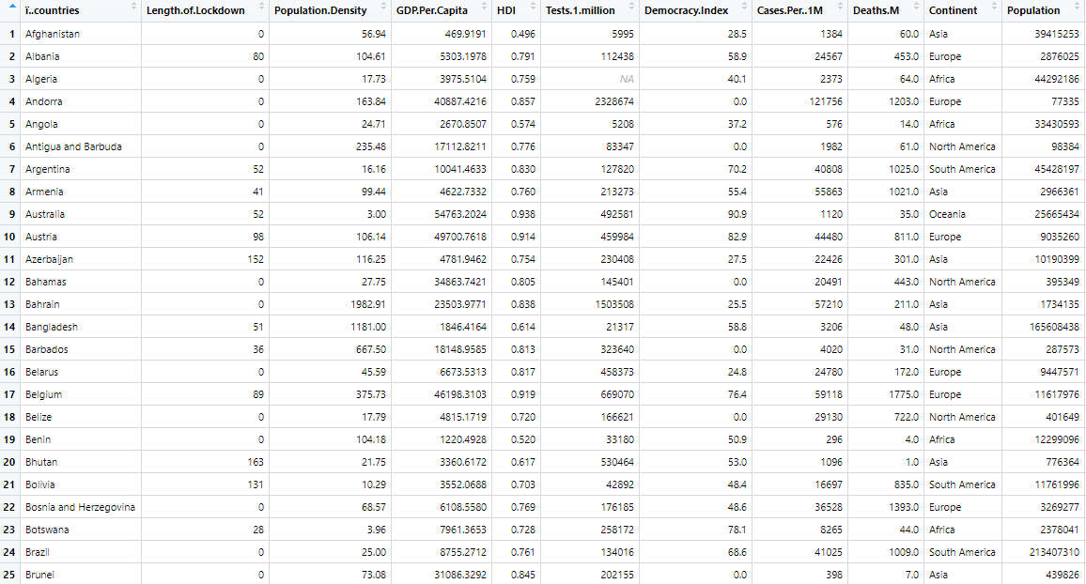
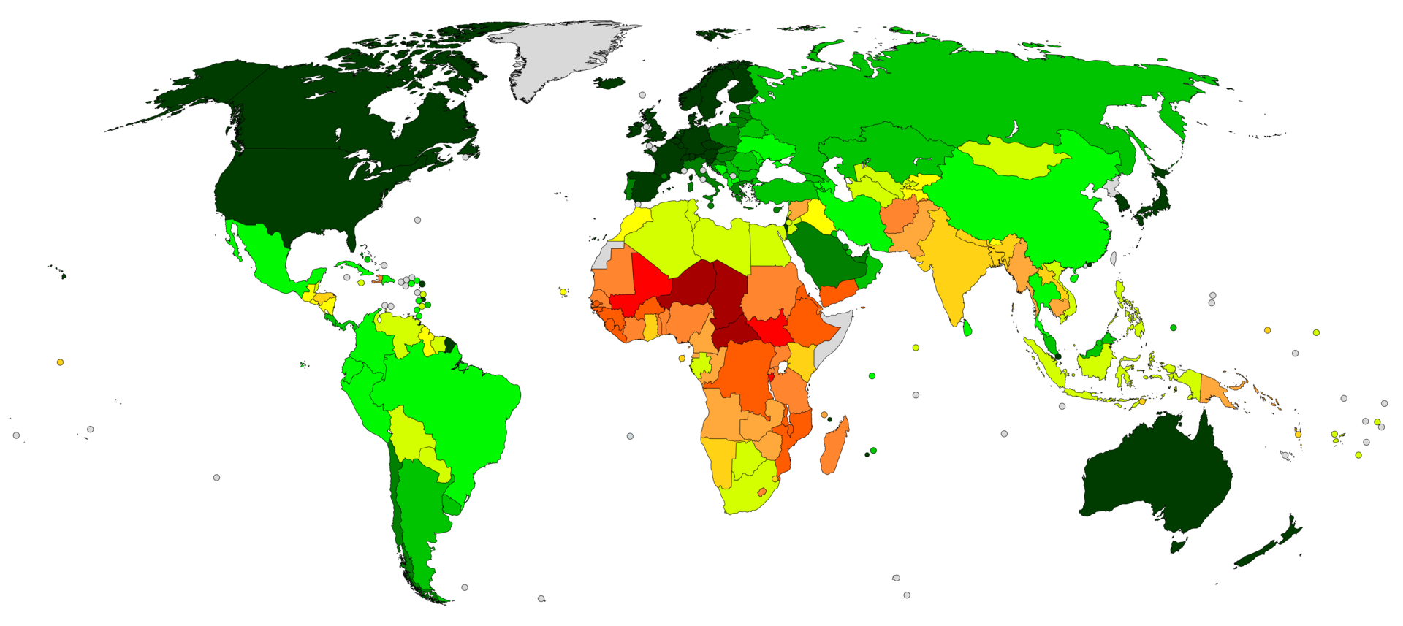
Data Collection
Source: Worldometer Website
www.worldometer.com
Response Variable:
No. of Covid-19 cases
No. of Covid- 19 deaths
Explanatory Variable:
Population density
GDP Per Capita
Human Development Index (HDI)
Tests per million
Democracy Index
Length of Lockdown.
Graphical Representation of Democracy Index.
Dark Green – More Democratic
Dark Red – Less Democratic

Slide 6
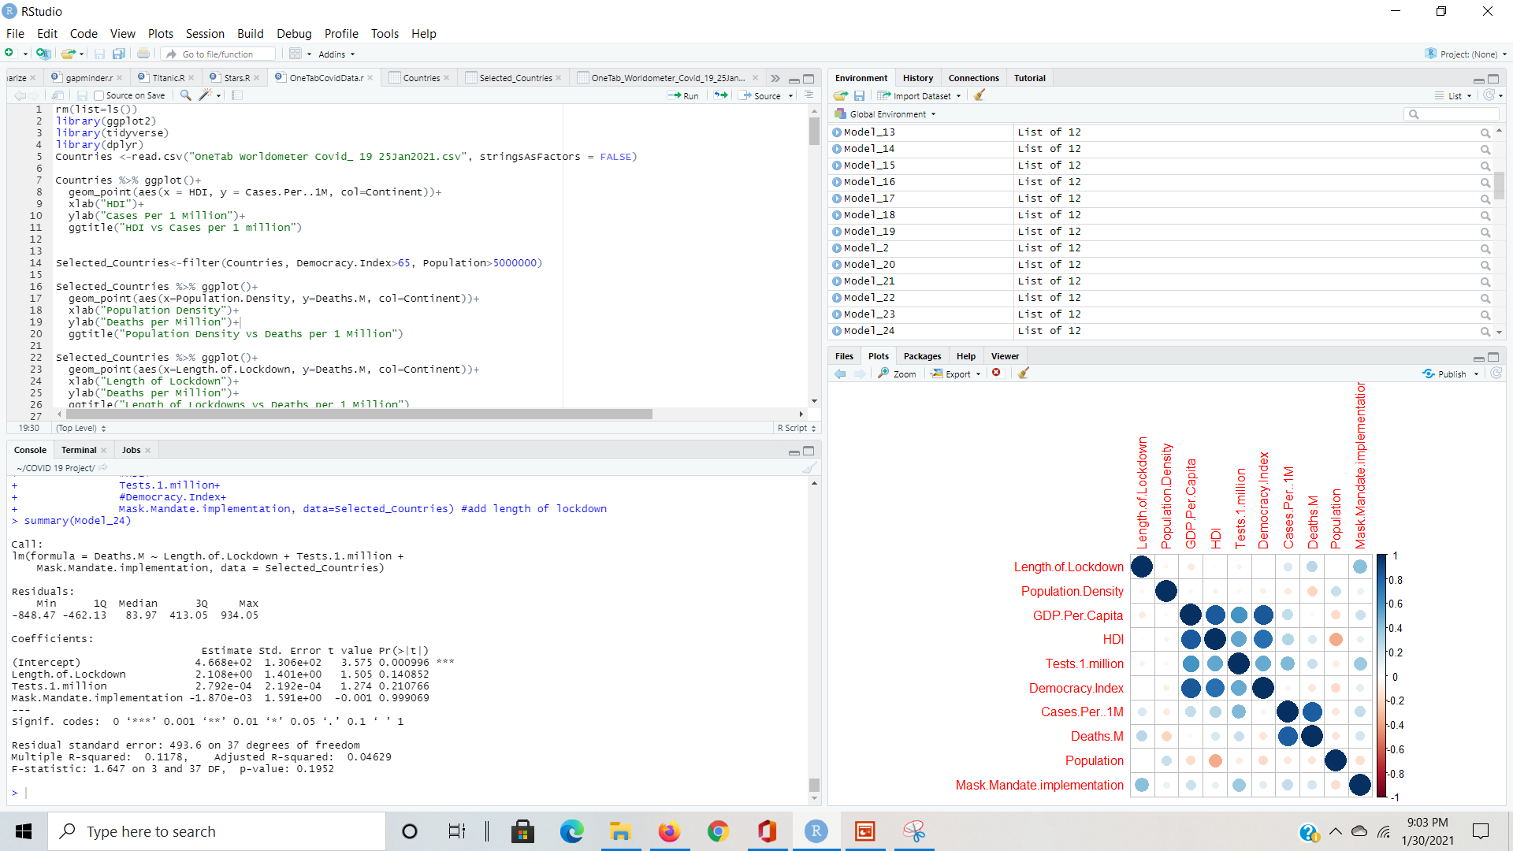
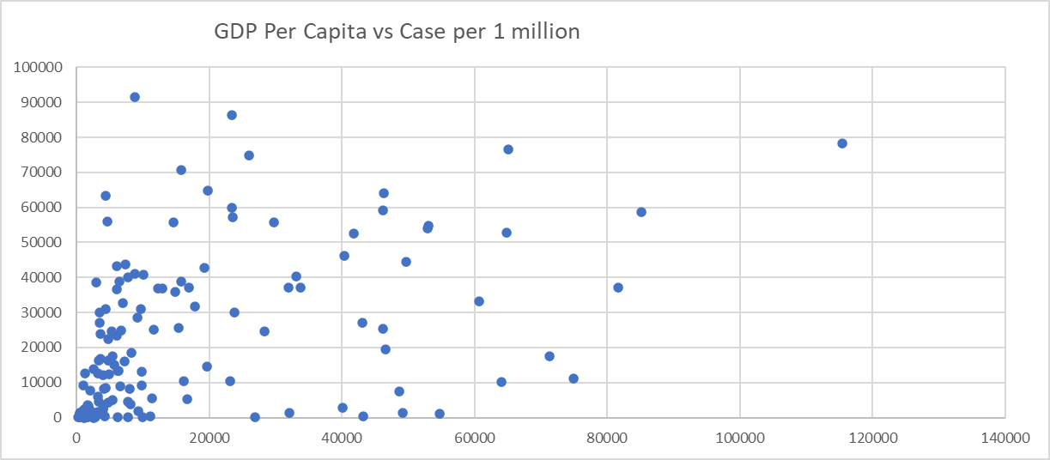
Statistical Programs
R-Studio
Excel
I used statistical programs
such as R studio and Excel
to look for patterns.

Slide 7
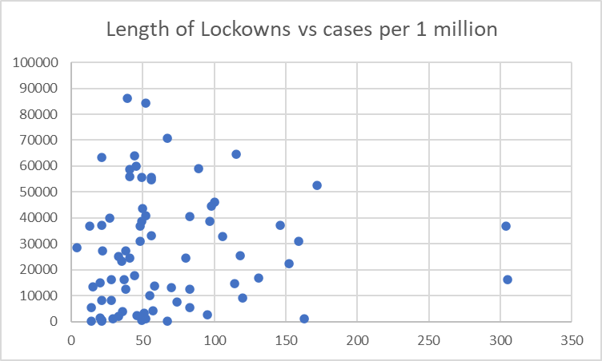
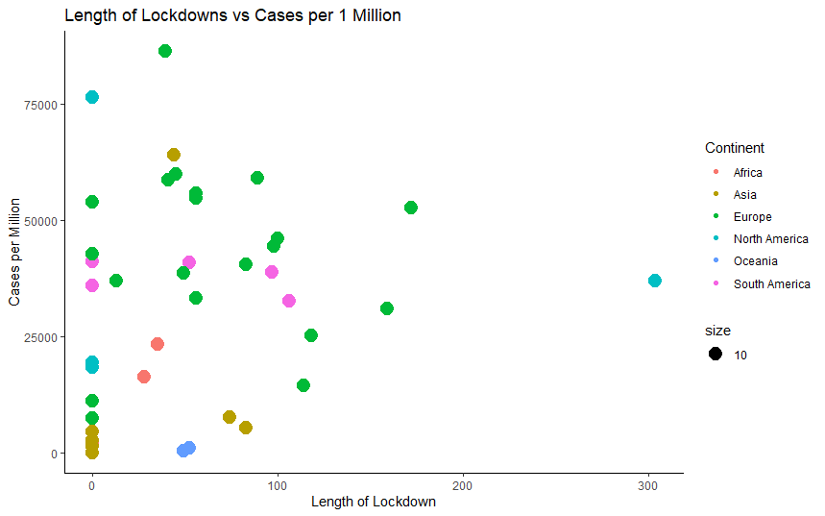
Scatter Plots to Spot Trends
All 134 countries
41 selected countries
Looking at all 134 countries in a single scatterplot made it difficult to see any obvious patterns.
Therefore, I used two criteria to further filter the data:
1. Population > 5M (to ensure countries are chosen with a substantial number of cases and deaths)
2. Democracy Index > 65 (to ensure that a free media can monitor the accuracy of government data.)
41 countries selected based on the criteria listed above.
  Even amongst these selected countries, data was still scattered and hard to spot a pattern.

Slide 8
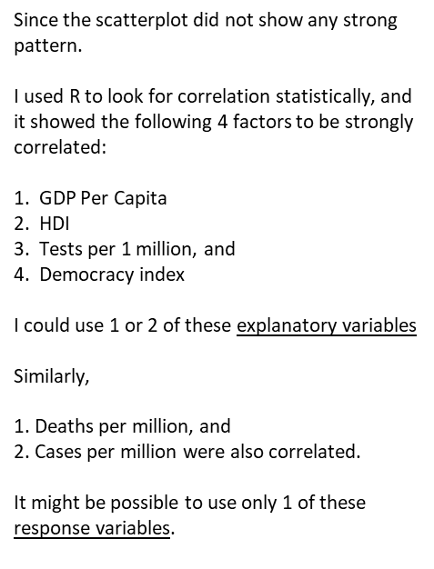
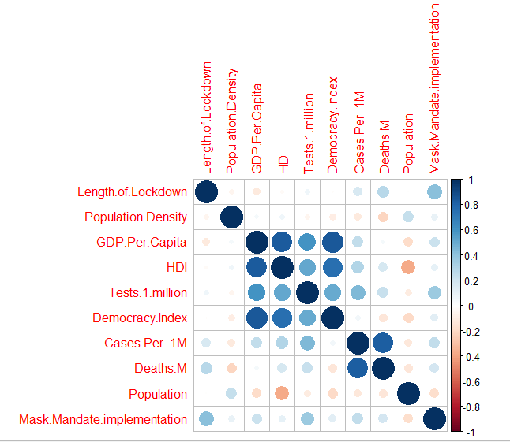

Correlation Plot in R

Slide 9
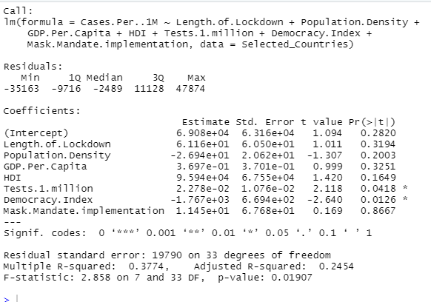
Linear Multivariable Regressions
Number of Cases (in Millions) = 69,080 + 61.116 x (Length of Lockdown) -2.69 x ( Pop. Density) + 0.369 x ( GDP Per Capita) + 95,940x (HDI) + 0.0227 x (Tests per Million) – 1767 x (Democracy Index) + 1.145 (Mask Mandate Implentation)

Slide 10
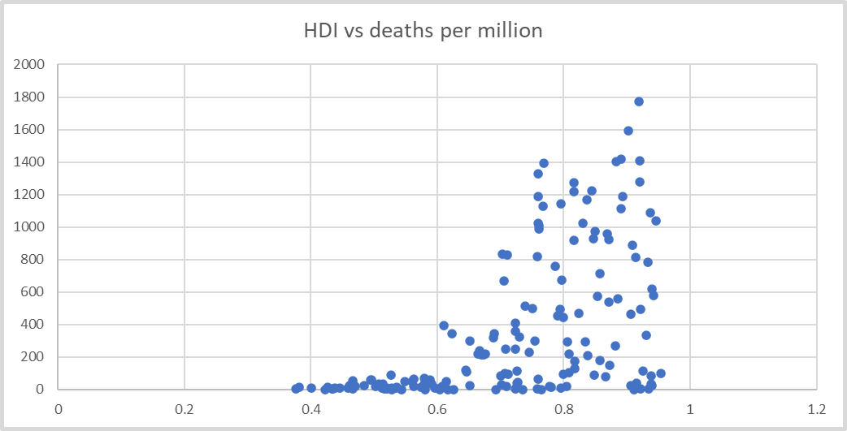
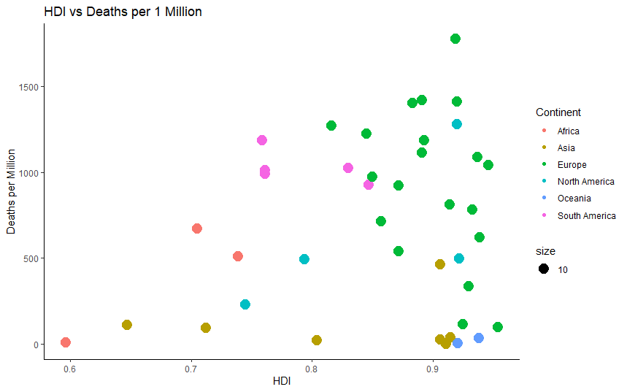
Scatter plots with All the Countries

